Slide 1
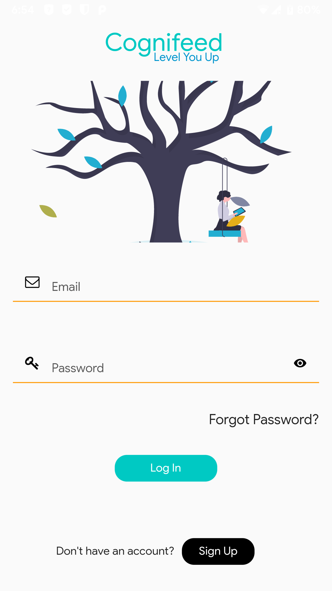
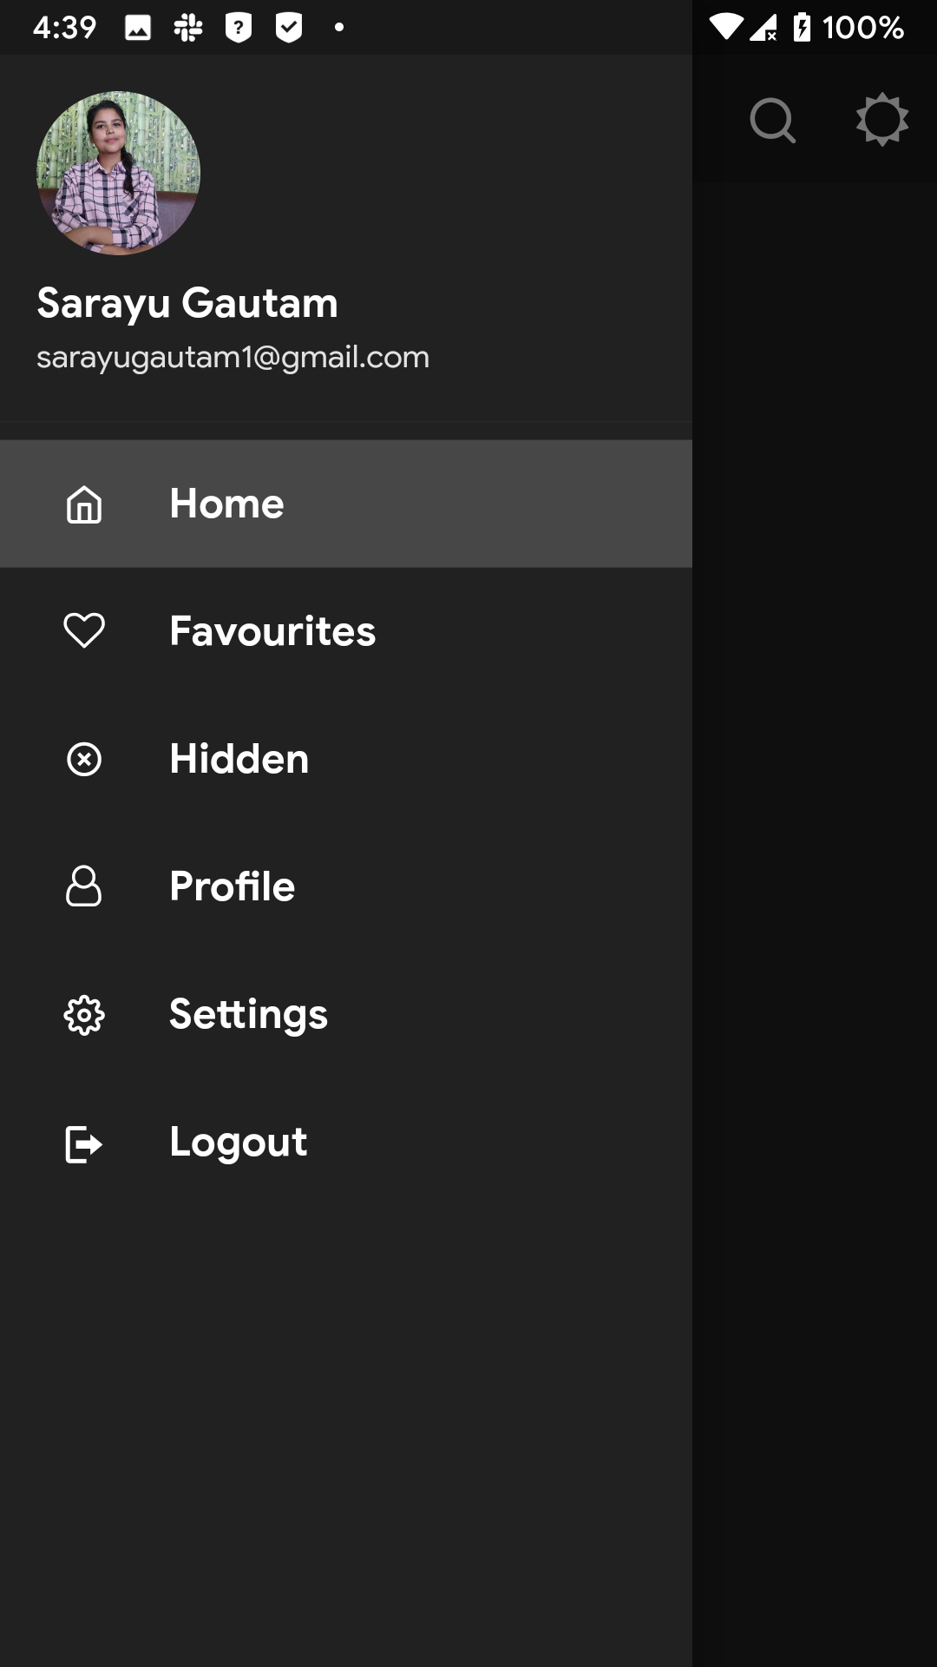
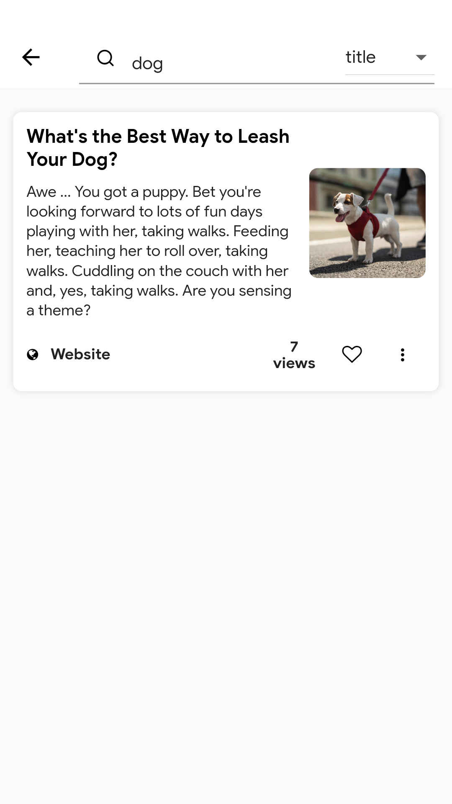


Slide 2
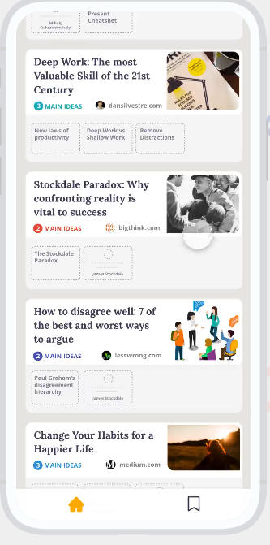
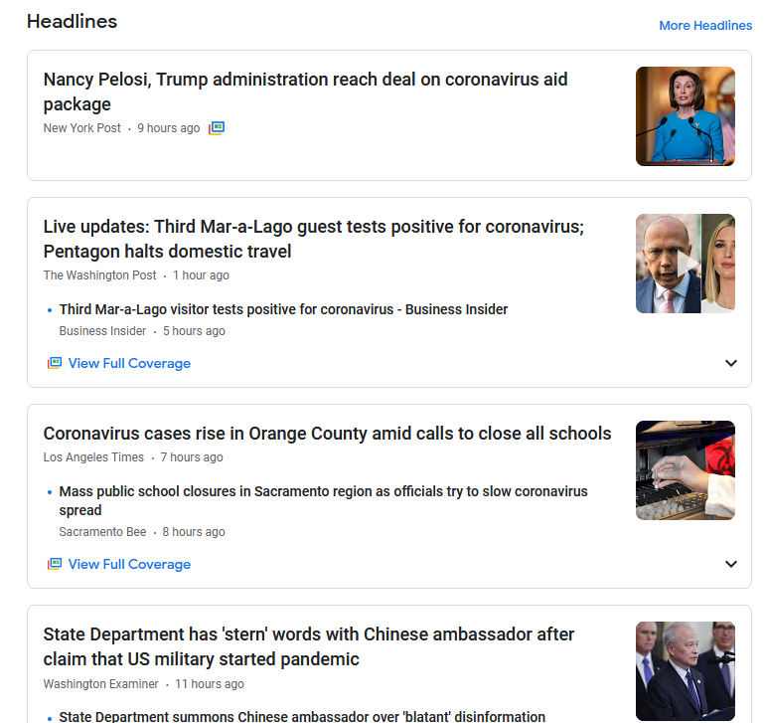
Literature Review
Deepstash
Flipboard
Google News

Slide 3
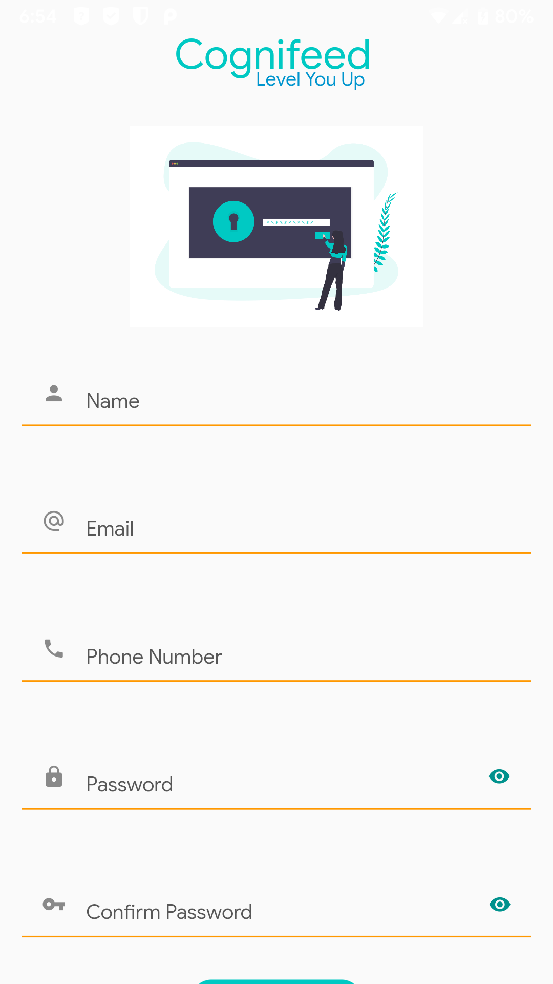
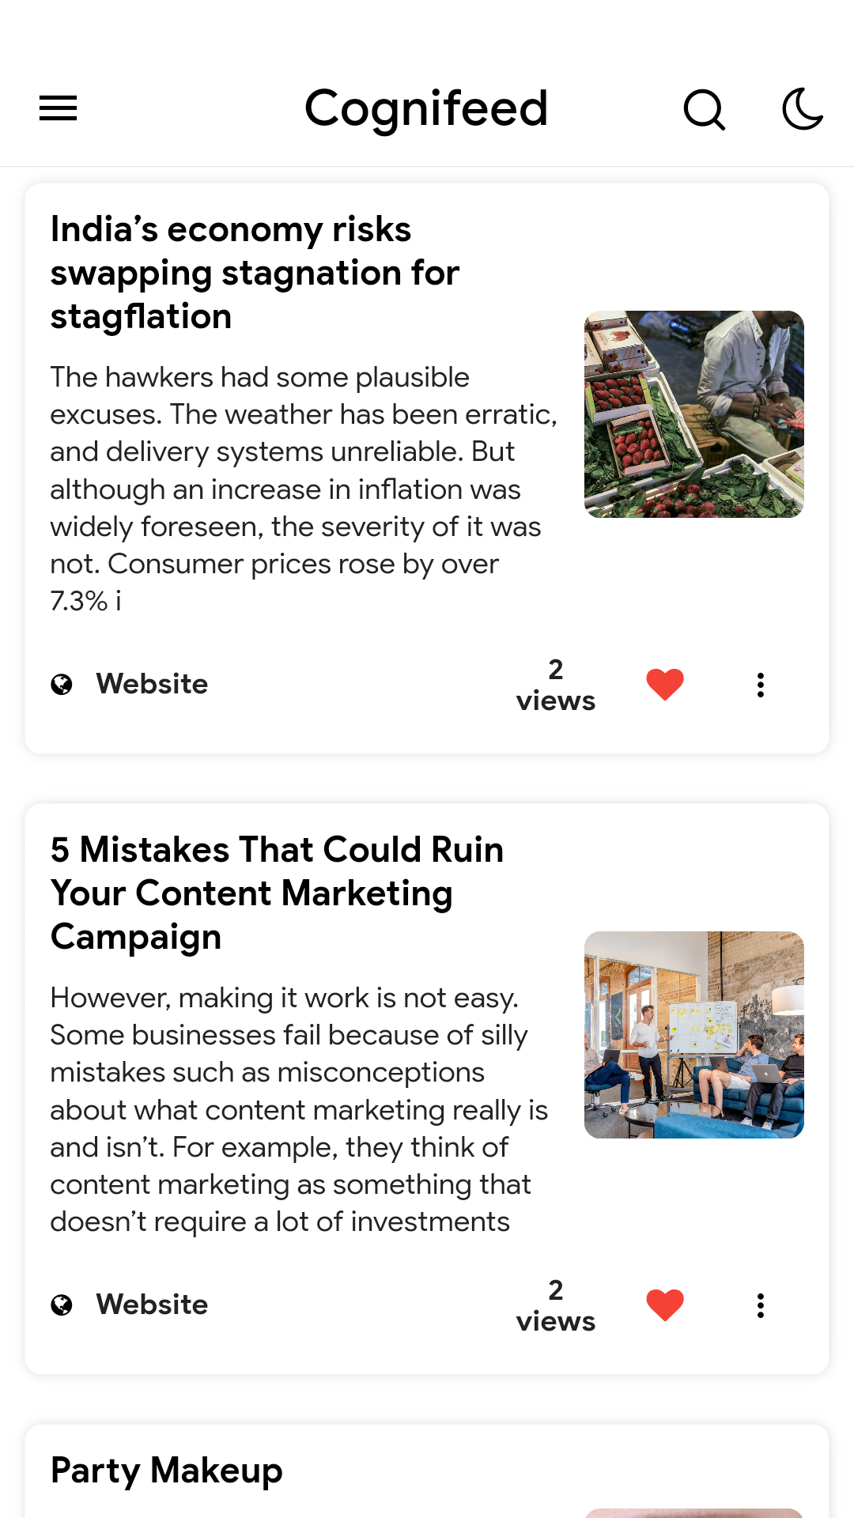
Introduction
Problem Faced
Lack of curated information on multiple topics
Limited to material on trending events
More distraction rather than enlightenment

Slide 4
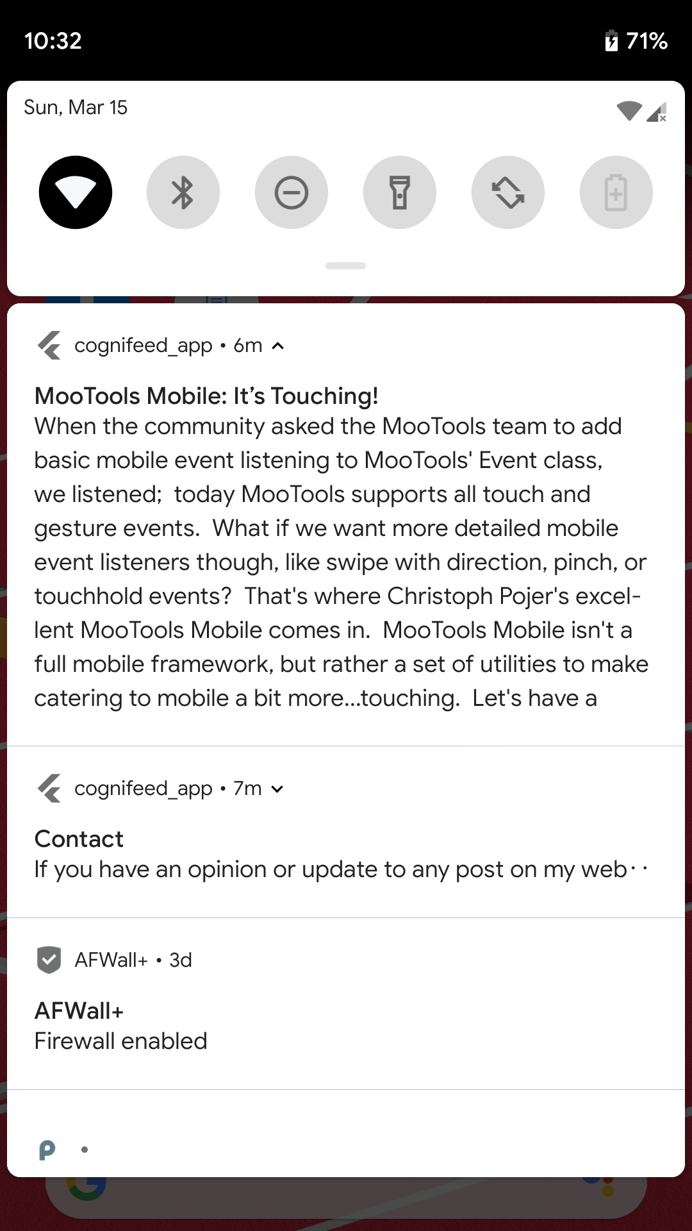
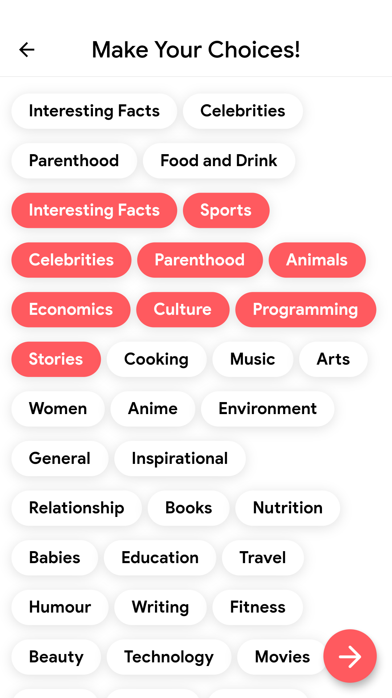
Objectives
Objectives
Create a platform to obtain refined information
Provide categories to different topics
Make user resourceful about various subject
Act as a quick refresher to a concept

Slide 5
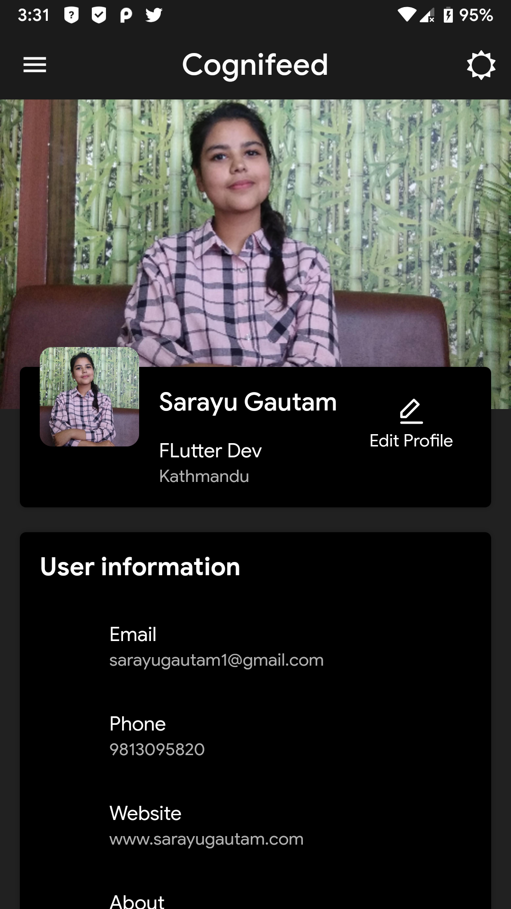
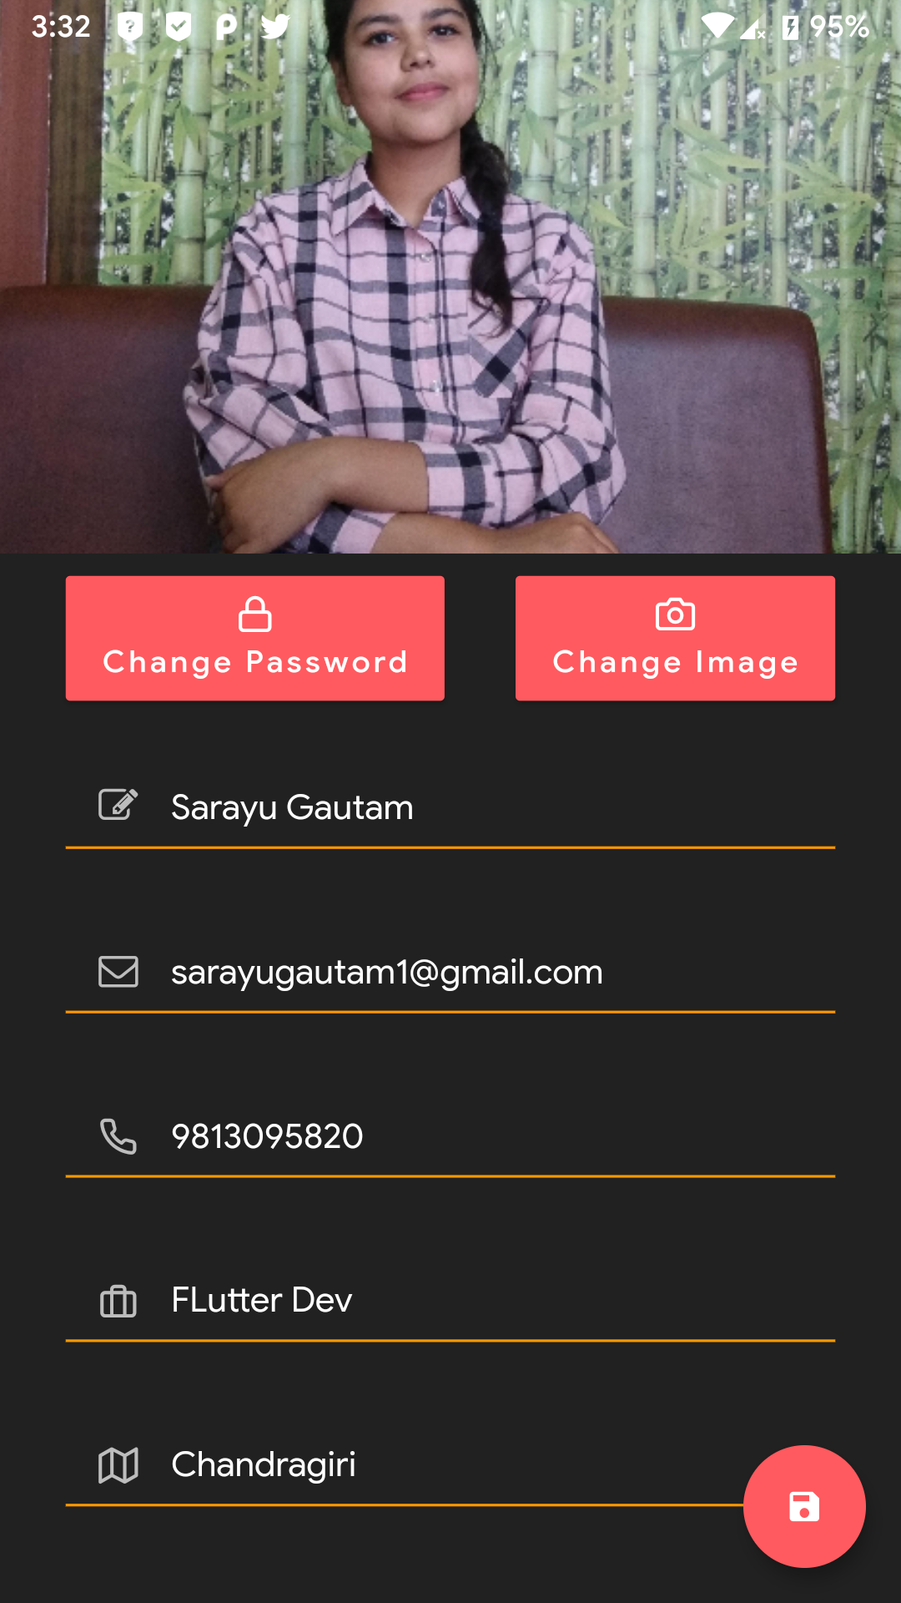
Features
Features
Curated information
Multi website surf result
Personalized selection of articles
Push notification
Save Favorite articles
Feature to share, hide and follow tags

Slide 6
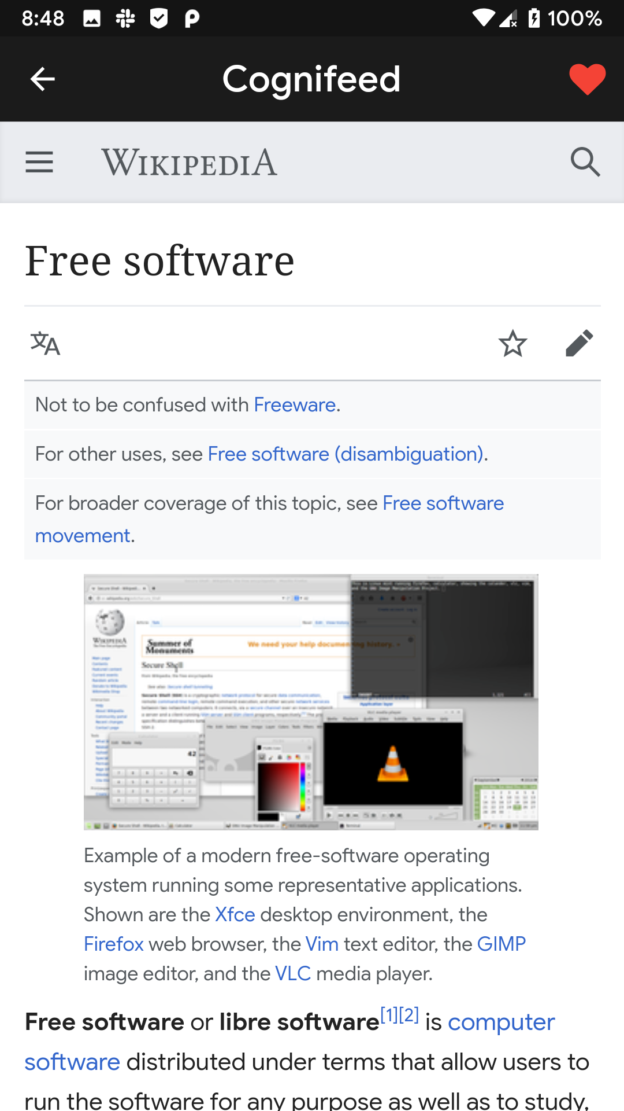
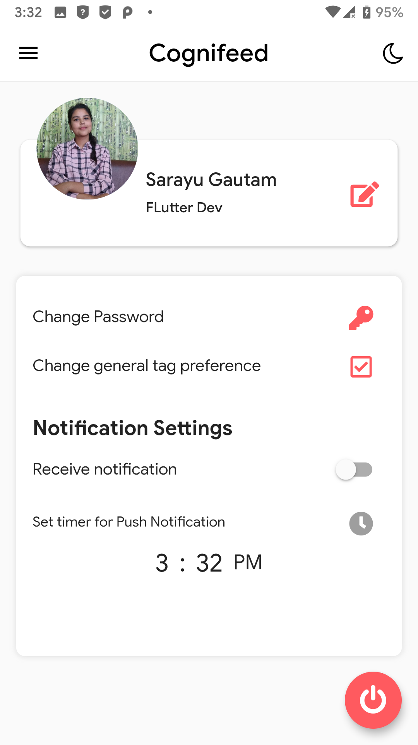
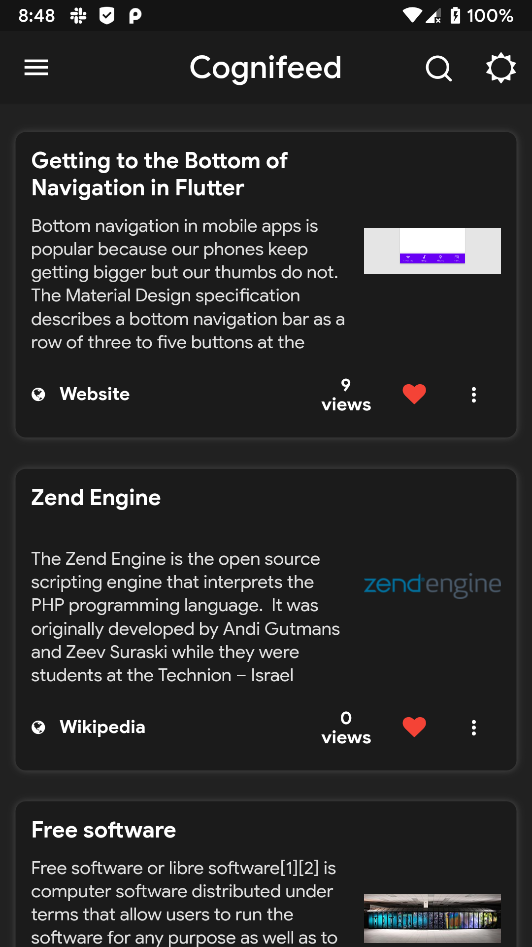
Implementation
Layout of the app
User authentication
Tags and websites selection
Spider design
Purifier design
API connection
Server implementation
Push notification
Unit tests and merge

Slide 7
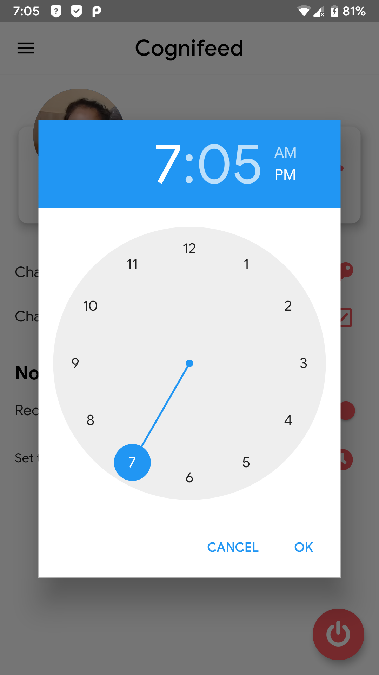
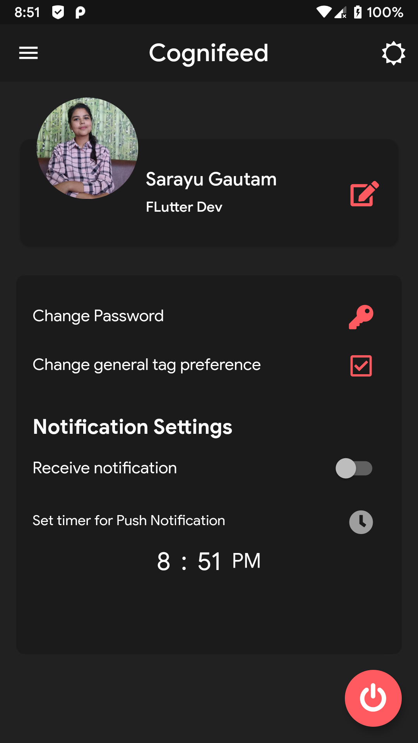
Limitations
Limitations
Doesn’t respond offline
Manual selection of tags and websites
Question on credibility of information
No feature to address changes in website
Low level server and limited scrapers
No recommendation system

Slide 8
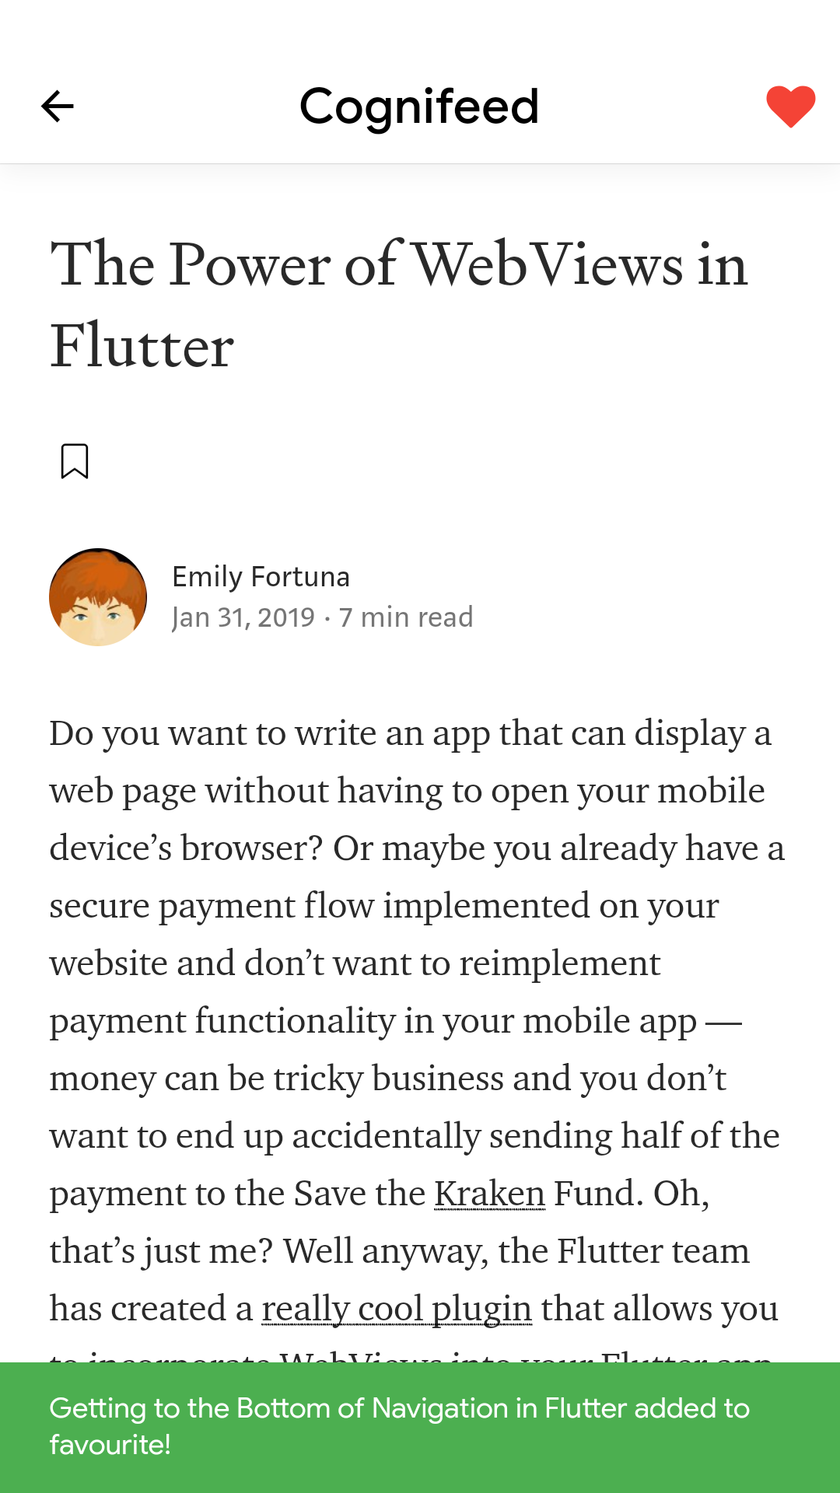
Future Enhancement
Offline functionality
Appropriate method to select tags
Appropriate classification of websites
Dynamic purification system
Effective recommendation system
IOS & Web platform to be developed

Slide 9
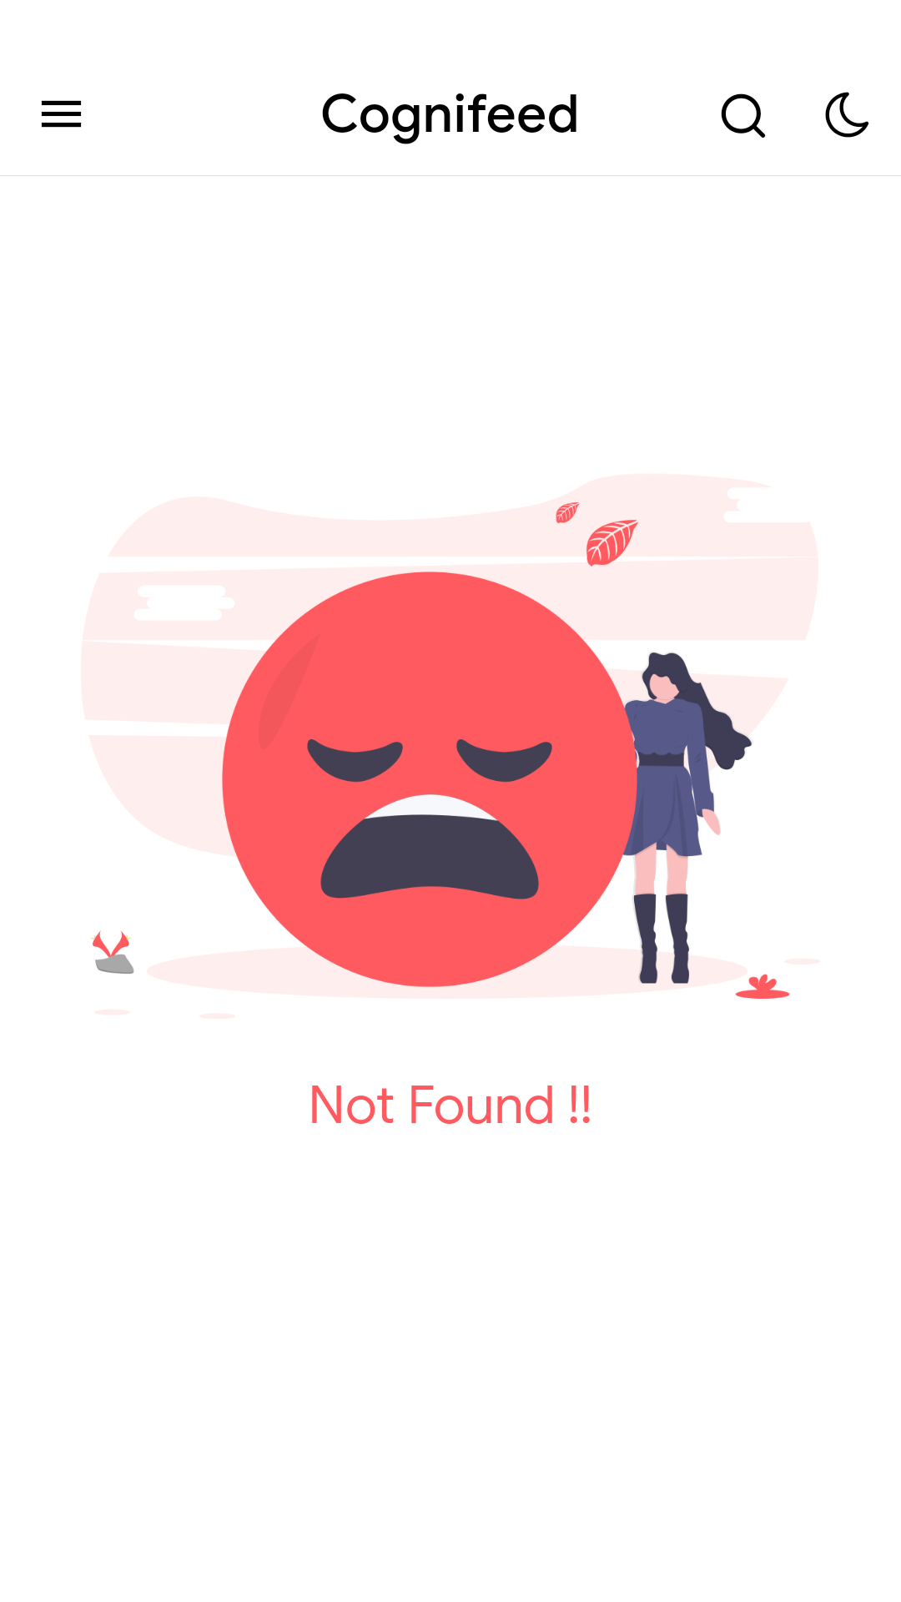
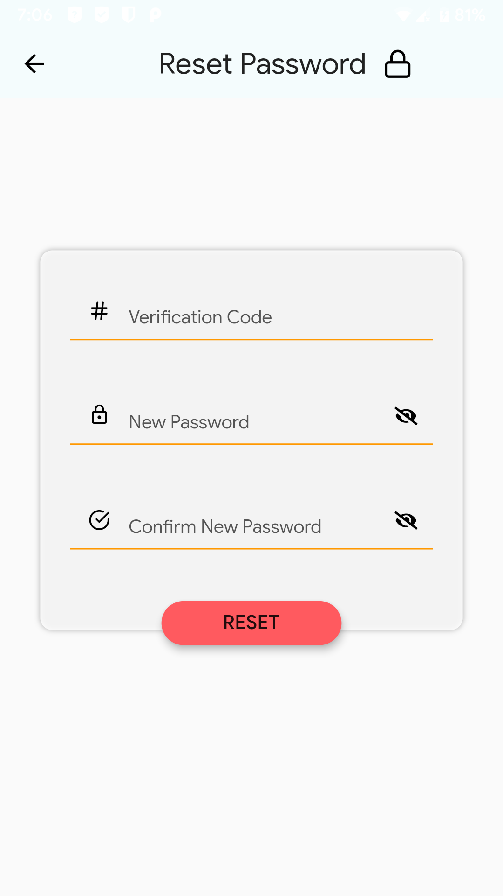
Features
Summary
Select tags to obtain articles
Share, favorite, hide articles per interest
Obtain push notifications
Follow/ Unfollow tags related to an article

Slide 10
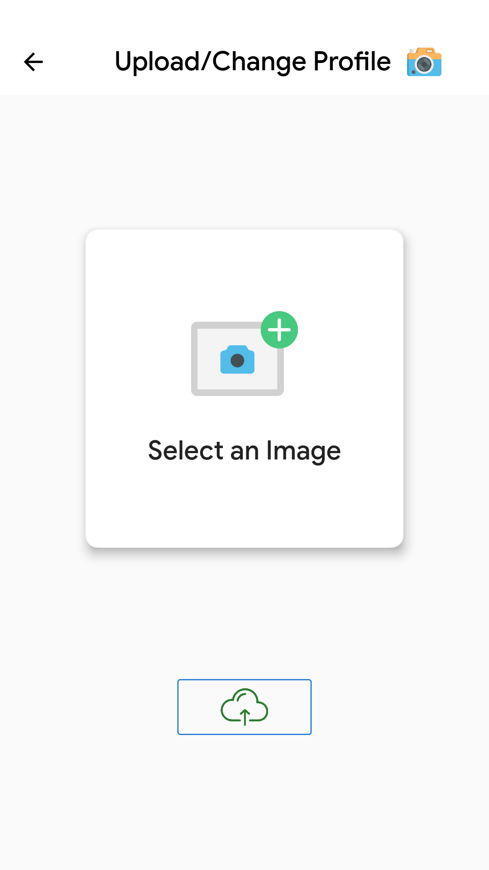
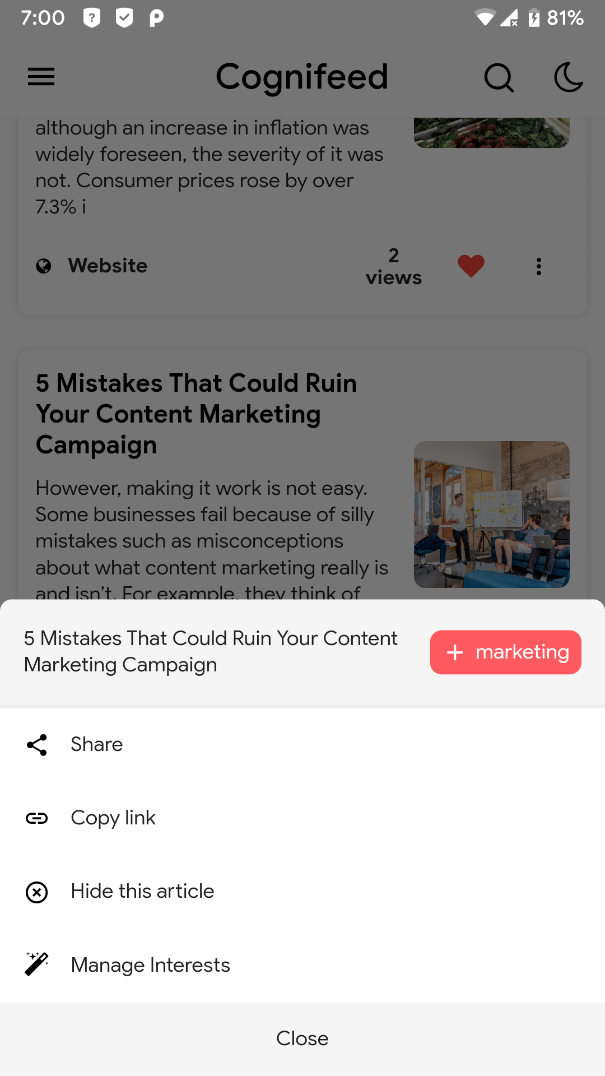
Project Involvement
Group Members
Sailesh Dahal
Sarayu Gautam
Bishant Bikram Pant
Aashish Pokharel
Shirish Sigdyal

